Slide 1
Machine Learning
“A field of study that gives computers the capability to learn without being explicitly programmed."

Slide 2
Naive Bayes Classifiers
collection of classification algorithms

Slide 3
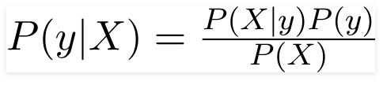
Principle of Naive Bayes Classifier
A Naive Bayes classifier is a probabilistic machine learning model that’s used for classification task. The crux of the classifier is based on the Bayes theorem.
Bayes theorem can be rewritten as:
It is not a single algorithm but a family of algorithms where all of them share a common principle, i.e. every pair of features being classified is independent of each other.

Slide 4
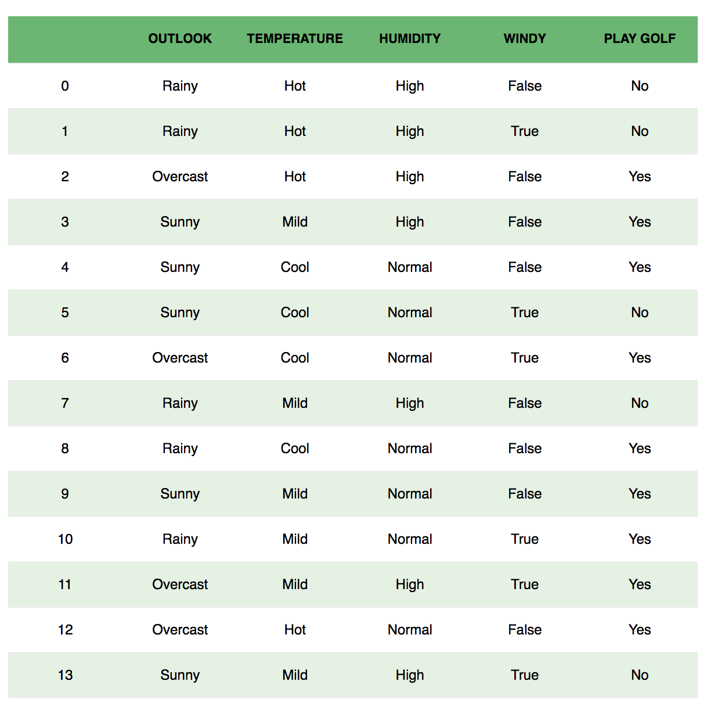
Example: Let us take an example to get some better intuition. Consider the problem of playing golf. The dataset is represented as below.

Slide 5
Principle of Naive Bayes Classifier cont’d
We classify whether the day is suitable for playing golf, given the features of the day. The columns represent these features, and the rows represent individual entries. If we take the first row of the dataset, we can observe that is not suitable for playing golf if the outlook is rainy, temperature is hot, humidity is high, and it is not windy.
We make two assumptions here:
One as stated above we consider that these predictors are independent. That is, if the temperature is hot, it does not necessarily mean that the humidity is high.
Another assumption made here is that all the predictors have an equal effect on the outcome. That is, the day being windy does not have more importance in deciding to play golf or not.

Slide 6

Principle of Naive Bayes Classifier cont’d
According to this example, Bayes theorem can be rewritten as:
The variable y is the class variable(play golf), which represents if it is suitable to play golf or not given the conditions. Variable X represent the parameters/features.

Slide 7

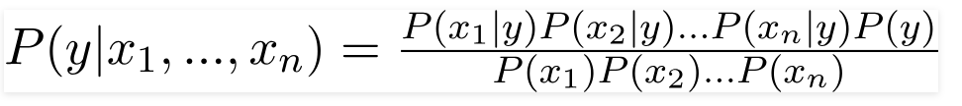

In our case, the class variable(y) has only two outcomes, yes or no. There could be cases where the classification could be multivariate. Therefore, we need to find the class y with maximum probability.
Principle of Naive Bayes Classifier cont’d
X is given as,
Here x1, x2, …., xn represent the features, i.e they can be mapped to outlook, temperature, humidity and windy. By substituting for X and expanding using the chain rule we get,
Now, you can obtain the values for each by looking at the dataset and substitute them into the equation. For all entries in the dataset, the denominator does not change, it remain static. Therefore, the denominator can be removed, and a proportionality can be introduced.

Slide 8

In our case, the class variable(y) has only two outcomes, yes or no. There could be cases where the classification could be multivariate. Therefore, we need to find the class y with maximum probability.
Principle of Naive Bayes Classifier cont’d
In our case, the class variable(y) has only two outcomes, yes or no. There could be cases where the classification could be multivariate. Therefore, we need to find the class y with maximum probability.
Using the above function, we can obtain the class, given the predictors.

Slide 9
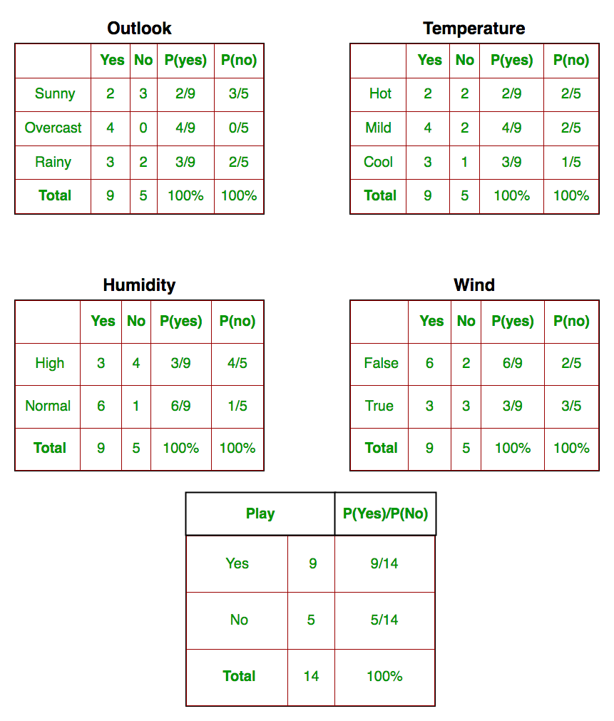
Principle of Naive Bayes Classifier cont’d
We need to find P(x_{i} | y_{j}) for each x_{i} in X and y_{j} in y. All these calculations have been demonstrated in the tables below:
In this figure, we have calculated P(x_{i} | y_{j}) for each x_{i} in X and y_{j} in y manually in the tables 1-4. For example, probability of playing golf given that the temperature is cool, i.e P(temp. = cool | play golf = Yes) = 3/9.

Slide 10
Types of Naive Bayes Classifier
Multinomial Naive Bayes: This is mostly used for document classification problem, i.e whether a document belongs to the category of sports, politics, technology etc. The features/predictors used by the classifier are the frequency of the words present.
Bernoulli Naive Bayes: This is similar to the multinomial naive Bayes but the predictors are boolean variables. The parameters that we use to predict the class variable take up only values yes or no, for example if a word occurs in the text or not.
Gaussian Naive Bayes: When the predictors take up a continuous value and are not discrete, we assume that these values are sampled from a gaussian distribution.

Slide 11
Conclusion
Naive Bayes algorithms are mostly used in sentiment analysis, spam filtering, recommendation systems etc.
They are fast and easy to implement but their biggest disadvantage is that the requirement of predictors to be independent.
In most of the real-life cases, the predictors are dependent, this hinders the performance of the classifier.

Slide 12
Decision Tree
Classification Algorithm

Slide 13
Overview
Decision tree algorithm falls under the category of supervised learning. They can be used to solve both regression and classification problems..
Decision tree builds classification or regression models in the form of a tree structure. It breaks down a dataset into smaller and smaller subsets while at the same time an associated decision tree is incrementally developed.
The final result is a tree with decision nodes and leaf nodes. A decision node (e.g., Outlook) has two or more branches (e.g., Sunny, and Rainy). Leaf node (e.g., Play) represents a classification or decision. The topmost decision node in a tree which corresponds to the best predictor called root node. Decision trees can handle both categorical and numerical data.

Slide 14
Overview cont’d
We can represent any boolean function on discrete attributes using the decision tree.
Types of decision trees
Categorical Variable Decision Tree: Decision Tree which has categorical target variable then it called as categorical variable decision tree.
Continuous Variable Decision Tree: Decision Tree which has continuous target variable then it is called as Continuous Variable Decision Tree.

Slide 15
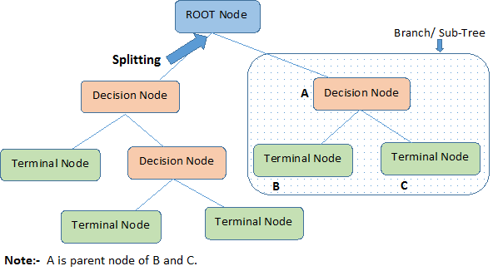
Overview cont’d
Root Node: It represents entire population or sample.
Decision Node: When a sub-node splits into further sub-nodes.
Branch / Sub-Tree: A sub section of decision tree is called branch or sub-tree.
Leaf/ Terminal Node: Nodes with no children.

Slide 16
Algorithms
Algorithms used in decision trees:
ID3
Gini Index
Chi-Square
Reduction in Variance
The core algorithm for building decision trees is called ID3. Developed by J. R. Quinlan and it uses Entropy and Information Gain to construct a decision tree.
The ID3 algorithm begins with the original set S as the root node. On each iteration of the algorithm, it iterates through every unused attribute of the set S and calculates the entropy H(S)or information gain IG(S) of that attribute. It then selects the attribute which has the smallest entropy (or largest information gain) value. The set S is then split or partitioned by the selected attribute to produce subsets of the data

Slide 17
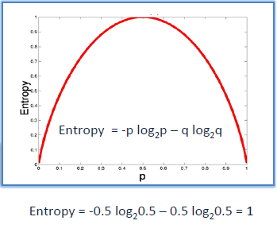
Entropy
Entropy is a measure of the randomness in the information being processed. The higher the entropy, the harder it is to draw any conclusions from that information. Decision tree algorithm uses entropy to calculate the homogeneity of a sample. If the sample is completely homogeneous the entropy is zero and if the sample is an equally divided it has entropy of one.

Slide 18
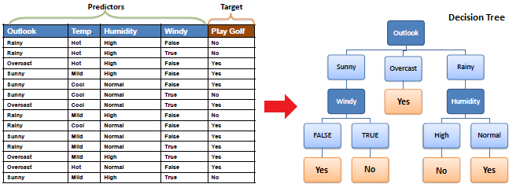
Example

Slide 19
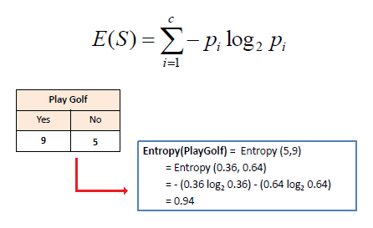
To build a decision tree, we need to calculate two types of entropy using frequency tables as follows:
a) Entropy using the frequency table of one attribute:

Slide 20
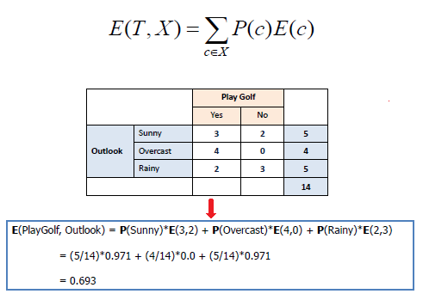
b) Entropy using the frequency table of two attributes:

Slide 21
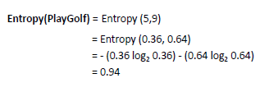
Information gain
The information gain is based on the decrease in entropy after a dataset is split on an attribute. Constructing a decision tree is all about finding attribute that returns the highest information gain (i.e., the most homogeneous branches).
Step 1: Calculate entropy of the target.

Slide 22
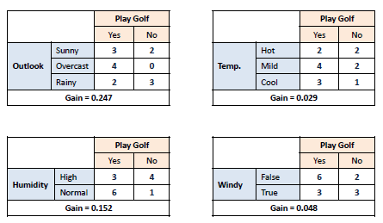
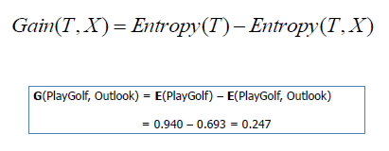
Step 2: The dataset is then split on the different attributes. The entropy for each branch is calculated. Then it is added proportionally, to get total entropy for the split. The resulting entropy is subtracted from the entropy before the split. The result is the Information Gain or decrease in entropy.

Slide 23
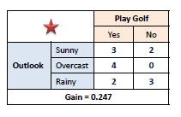
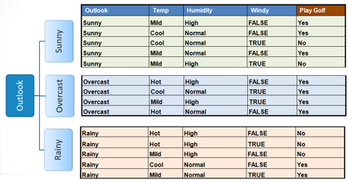
Step 3: Choose attribute with the largest information gain as the decision node, divide the dataset by its branches and repeat the same process on every branch.

Slide 24
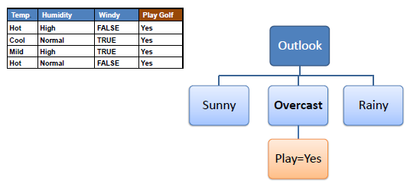
Step 4a: A branch with entropy of 0 is a leaf node

Slide 25
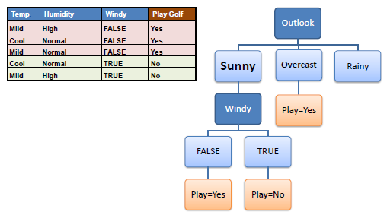
Step 4b: A branch with entropy more than 0 needs further splitting

Slide 26
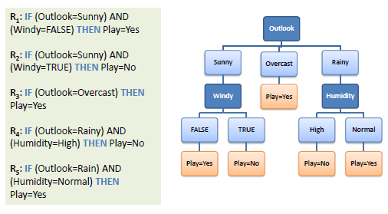
Step 5: The ID3 algorithm is run recursively on the non-leaf branches, until all data is classified.

Slide 27
Let’s write some codes!

Slide 28
Limitations to Decision Trees
Decision trees tend to have high variance when they utilize different training and test sets of the same data, since they tend to overfit on training data. This leads to poor performance on unseen data. Unfortunately, this limits the usage of decision trees in predictive modeling.
To overcome these problems we use ensemble methods, we can create models that utilize underlying(weak) decision trees as a foundation for producing powerful results and this is done in Random Forest Algorithm

Slide 29
Random forest

Slide 30
Definition
The Random Forest algorithm is a supervised classification algorithm based on Decision Trees. Also known as random decision forests, it is a popular ensemble method used to build predictive models for both classification and regression problems.
In the context of Random Forests, "ensemble" refers to the collective decisions of multiple Decision Trees. In a Random Forest (RF), predictions are made not based on a single Decision Tree but by combining the predictions of 'K' Decision Trees, typically through a majority vote or averaging.

Slide 31
Construction
'K' individual Decision Trees are created from a given dataset by randomly dividing the dataset and the feature subspace using a process called Bootstrap Aggregation (Bagging). Bagging involves random selection with replacement. Generally, two-thirds of the dataset (row-wise) is selected through bagging. On this selected dataset, another process called Attribute Bagging is performed to further enhance diversity among the Decision Trees.

Slide 32
Now Attribute Bagging is done to select 'm' features from given M features, (this Process is also called Random Subspace Creation). Generally, value of 'm' is square-root of M. Now we select say, 10 such values of m, and then Build 10 Decision Trees based on them, and test the 1/3rd remaining Dataset on these(10 Decision Trees).We would then Select the Best Decision Tree out of this. And Repeat the whole Process 'K' times again to build such 'K' decision trees.
Classification
Prediction in Random Forest (a collection of 'K' Decision Trees) is truly ensemble ie, For Each Decision Tree, Predict the class of Instance and then return the class which was predicted the most often.

Slide 33
Let’s code it!

Slide 34
Parameters
Let’s understand and try with some of the tuning parameters.
n_estimators : Number of trees in forest. Default is 10.
criterion: “gini” or “entropy” same as decision tree classifier.
min_samples_split: minimum number of working set size at node required to split. Default is 2.
Play with these parameters by changing values individually and in combination and check if you can improve accuracy.

Slide 35
Final Thoughts
The Random Forest Classifier, as an ensemble algorithm, tends to deliver more accurate results. This is because it works on the principle that a combination of weak estimators can form a strong estimator.
Even if one or a few Decision Trees are prone to noise, the overall result is likely to remain accurate. For example, even with a relatively small number of estimators, the algorithm can achieve a high accuracy of above 97%.

